Slide 1
Percentage Flags
For each of the flags calculate the different areas and give the percentage of each colour

Slide 2
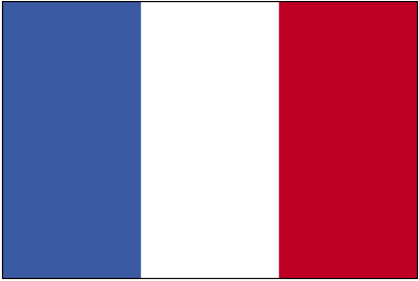
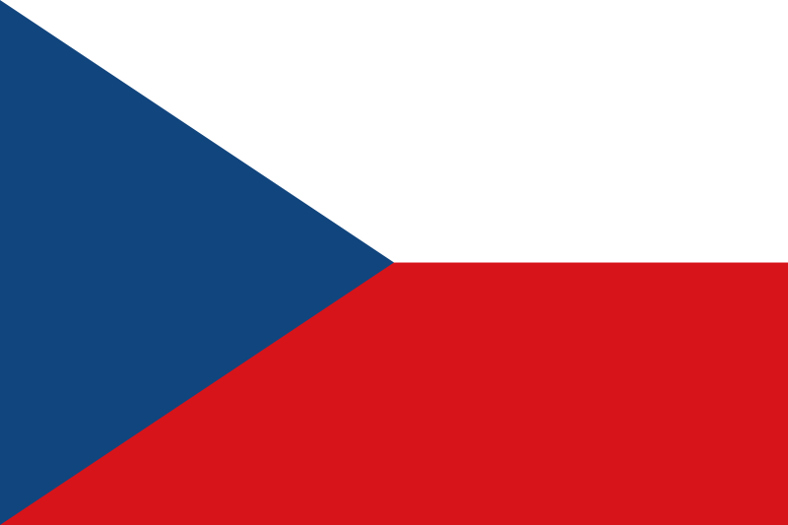
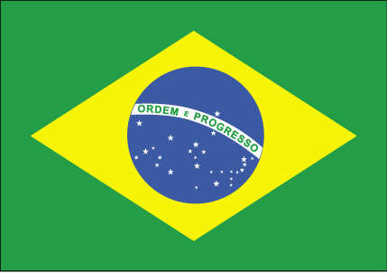

Slide 3
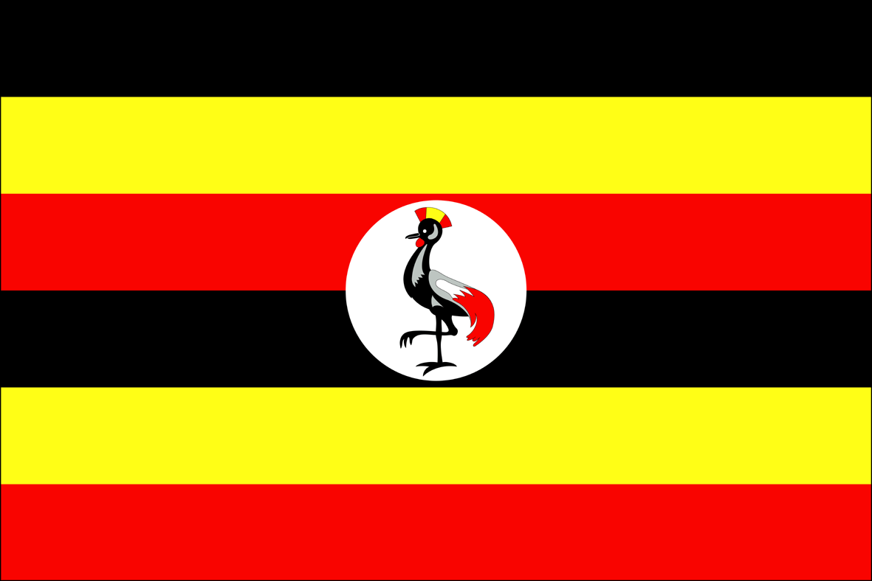

Slide 4
Malta

Slide 5
France

Slide 6
Spain

Slide 7
Denmark

Slide 8
Czechoslovakia

Slide 9
Chile

Slide 10
Brazil

Slide 11
Zimbabwe

Slide 12
Japan

Slide 13
Cuba

Slide 14
Scotland

Slide 15
Uganda

Slide 16
Antigua & Bermuda

Slide 17
Nepal

Slide 18
Israel

Slide 19
Kuwait

